Slide 1


KALLAM HARANADHA REDDY INSTITUTE OF TECHNOLOGY (Autonomous) Approved by AICTE,New Delhi, Permanently Affiliated to JNTUK,Kakinada Programs Accredited by NBA:B.Tech.in EEE,ME,ECE&CSE Department of DCME
Image to Sketch Application using AI
PRESENTED BY:BATCH NO 6 UNDER THE GUIDANCE OF
Y.Bhanu Sai (23608-CM-064) (TL) M.Prasad Rao
G.Nanda Kishore (22608-CM-013)
G.Bhaskar (23608-CM-010)
K. Akash (23608-CM-071)

Slide 2
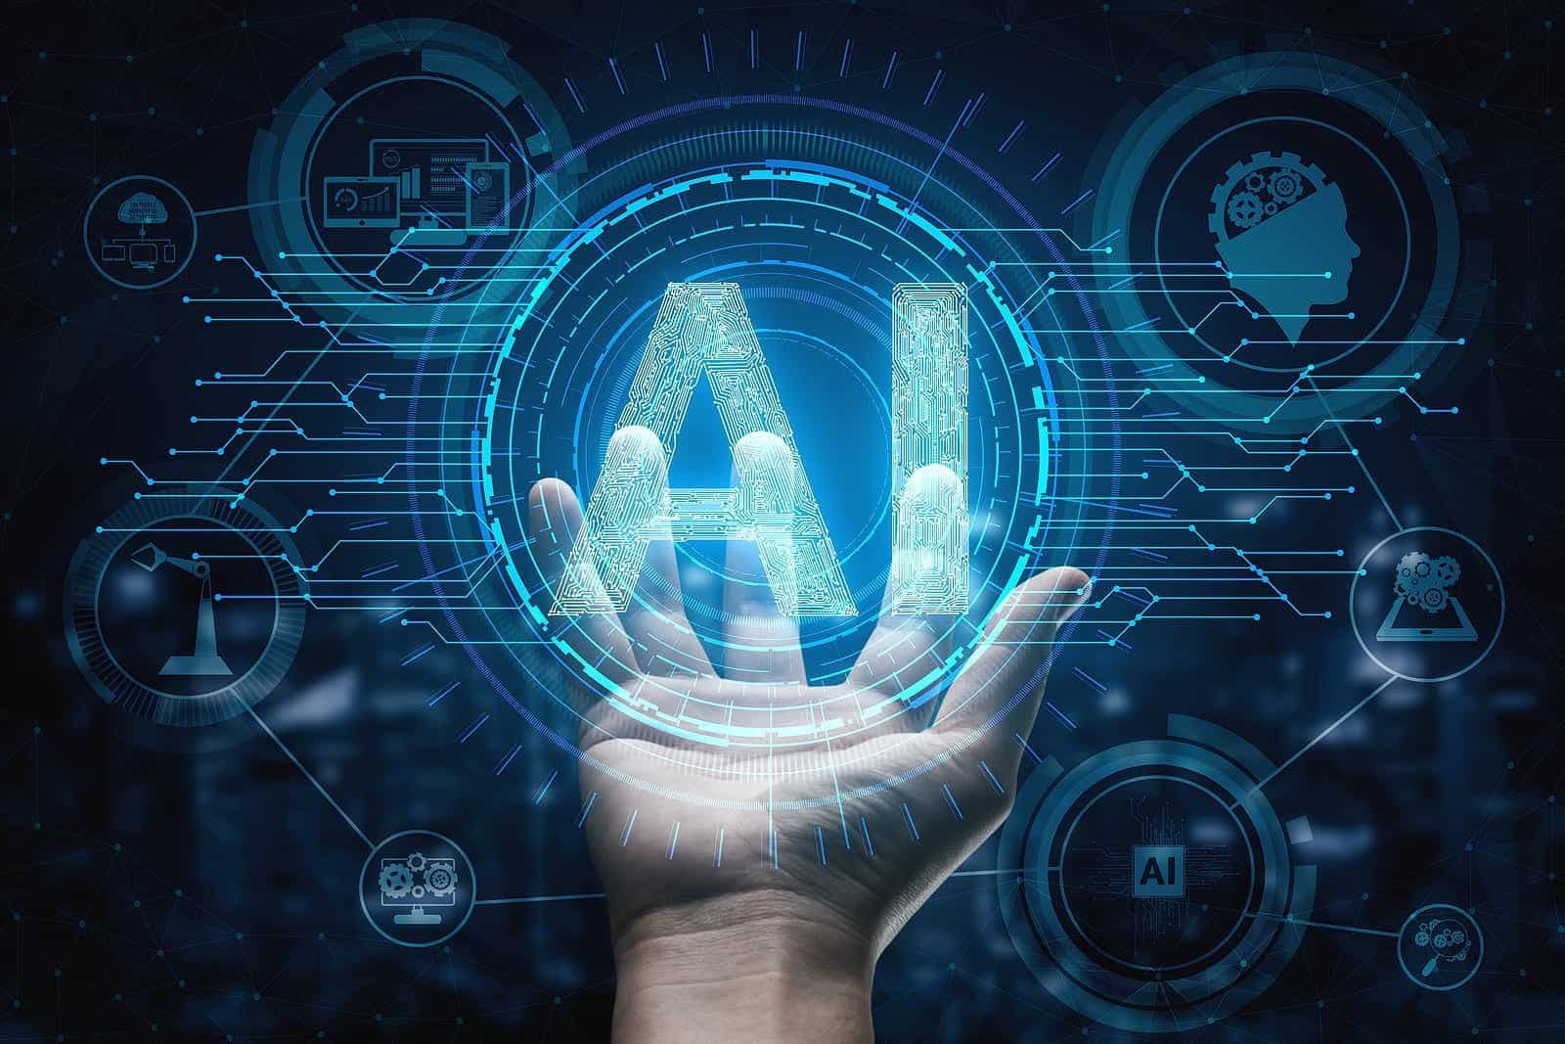
Image to Sketch Application using AI

Slide 3
CONCEPTS
Abstract
Benefits
Features
Requirements
Conclusion
Future Scope
References

Slide 4
ABSTRACT
The Image to Sketch Application is a software tool that converts regular photos into pencil sketch-like images using image processing techniques. The main goal of this project is to provide a fun and creative way for users to transform their pictures into artistic sketches with just a few clicks.
This application uses computer vision techniques, often with the help of Python libraries like OpenCV. The process involves reading the input image, converting it to grayscale, inverting it, applying Gaussian blur, and then blending it to create a sketch effect. These steps mimic the look of a hand-drawn pencil sketch.
It is a lightweight, easy-to-use tool that can be used in photo editing, digital art, social media content creation, and educational purposes. Users can upload an image, preview the result, and save the sketch to their device.
The project highlights the power of simple image processing algorithms and how they can be applied to build creative tools that are both practical and fun to use.

Slide 5

BENEFITS
Easy to Use – Anyone can use the app by just uploading a photo, no need for editing skills.
Saves Time – It quickly turns a photo into a pencil sketch within seconds.
Looks Real – The sketches look like they were drawn by hand, thanks to AI.
Creative Fun – Great for people who enjoy art, drawing, or photo editing.
Free Alternative – No need to hire an artist or use paid apps.
Good for Social Media – Helps create unique and attractive posts or profile pictures.

Slide 6

FEATURES
Converts real images into pencil-style sketches
Uses AI for better quality and accuracy
Fast and simple interface
Great for creative projects, posters, or fun editing
One-click sketch generation
Fun tool for social media profile pics or posts

Slide 7
REQUIREMENTS
Hardware Requirements
Personal Computer or Laptop with latest processors,8GB internal storage with 256GB SSD Storage
Software Requirements
Operating System: Windows, Linux, or macOS
Programming Language: Python (latest version preferred)
AI Libraries: TensorFlow ,PyTorch,Streamlit
Image Processing Library: OpenCV
Numerical Computation: NumPy
IDE/Code Editor: VS Code, PyCharm, or Jupyter Notebook or Andriod Studio(for App Development)
Package Manager: pip or conda (to install Python libraries)

Slide 8
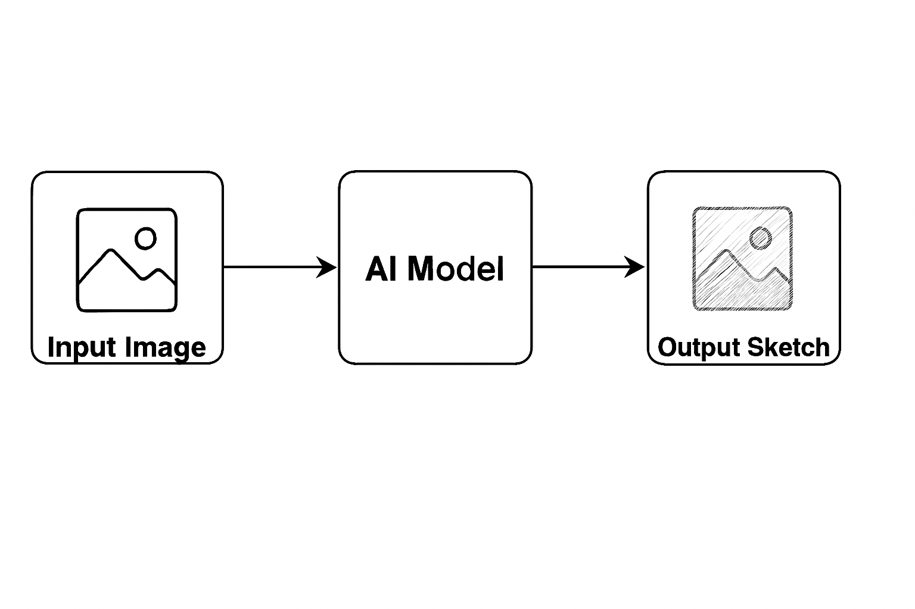
Architecture:

Slide 9

CONCLUSION
An Image to Sketch AI application is a powerful tool that uses artificial intelligence to turn real images into artistic sketches. With basic hardware like a mid-range CPU, some RAM, and a GPU (optional), and software tools like Python, OpenCV, and Streamlit, anyone can build this project easily. It is useful for students, artists, developers, and hobbyists, offering creative and fun results with simple tools. As AI continues to grow, this type of application shows how technology can blend with art in exciting ways.

Slide 10
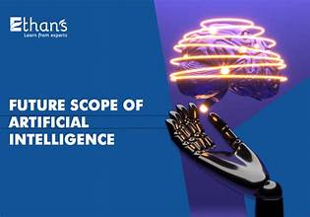
FUTURE SCOPE
In the future, this Image to Sketch application can be improved with more advanced features. Different sketch styles such as color pencil, charcoal, or shading effects can be added to give users more creative options. A real-time camera mode can be developed so users can see sketch effects live while taking a photo. The app can also be converted into a mobile version for Android and iOS devices, making it more accessible. With more training data, the AI model can become even more accurate and produce better sketch quality. Simple editing tools like brightness, contrast, and erase options can be added for better control. Features like background removal or blur can help highlight the main subject. Additionally, users can be given options to directly share their sketches on social media, and an offline mode can be included to use the app without internet once downloaded.

Slide 11
THANK YOU

